Slide 1
NetMRI Overview & Update
Chris Hindy, Director Pre-sales Engineering
Empowered Networks

Slide 2

Infoblox NetMRI at a glance
Supports network devices from more than 65 manufacturers
Supports Cisco devices in ACI mode
Discover
Archive Configs
Apply Policy
Alert
Report
Make Changes
On demand and scheduled reports (PDF, XLS, DOC, or HTML)
Capture every configuration change to every device
Automatically…
Network Analysis provides 200+ best practices
Integration with enterprise tools via SNMP Traps, Syslog
Northbound & Southbound RESTful API integration
PCI, DISA STIG, NSA policy out of the box
Templates for “gold standard” configs
Scripted Changes in Python, Perl,or CCS

Slide 3



NetMRI Advisor at a glance
Security Advisories
& Alerts
End of Sale /
End of Support
NetMRI Advisor
NetMRI Advisor is an add-on subscription service for Infoblox NetMRI that provides additional security and lifecycle data.

Slide 4

NetMRI Advisor Business Value
Automates the task of finding devices affected by security bulletins or devices headed for end-of-life
Constantly updated feed of security bulletins from leading manufacturers
Feed pre-filtered for your specific device models
Putting details in NetMRI lets you use reports, searches and notifications already available in NetMRI
Notes:
Image credit: CC BY 2.0 “My Profits and Losses” by gina pina on Flickr

Slide 5
Why NetMRI?
Discover everything on your network (end devices and network devices
Sync actual IP Address usage to IPAM
Test network device configuration matches expectations
Automate fixing problems when they happen
Promote consistency across your environment

Slide 6
7.3.1 by the numbers
New Devices
86
Bugs Fixed
113

Slide 7
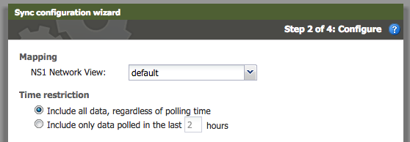
Changes to NIOS IPAM Sync
Device last polled time restriction workaround
Time limit for last polled time now variable
Alternately, time limit can be removed altogether

Slide 8
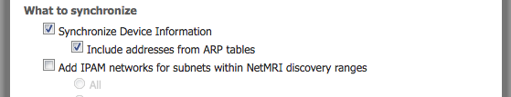
Changes to NIOS IPAM Sync
Additional ARP Table Data is available for sync
VRF and BGP data now flow over to IPAM

Slide 9
Does it work with (Meraki/Viptella/Ubiquiti/Talari/…)?
SD-WAN first-class support is still under development
7.3.1 adds new API endpoint for consuming device configuration
/api/3.3/config_revisions/docs#import_custom_config
Device needs to exist in NetMRI (DeviceID is a required parameter)
User is responsible for pulling and formatting the config from the device side
Caveat: Bypasses username tracking in Config Archive

Slide 10
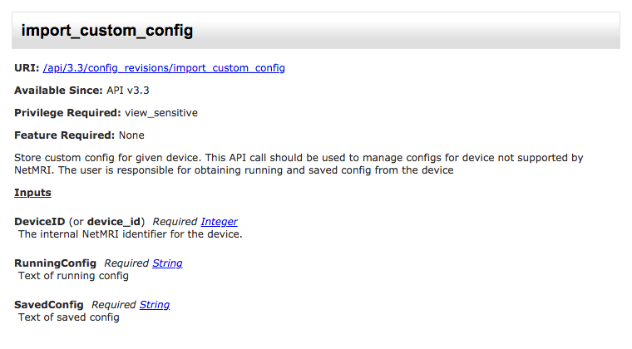
Docs

Slide 11
Basic Design
Connect to the device or service endpoint, pull config(s)
Match device in NetMRI, get the DeviceID
Push the config to NetMRI using import_custom_config

Slide 12
Python Example
def main():
"""Start the main loop."""
args = get_args()
config = get_config()
ipaddress = args["ipaddress"]
mt_config = get_mikrotik_config(config, ipaddress)
deviceid = get_mt_device_id(config, ipaddress)
result = put_config_to_netmri(config, deviceid, mt_config, mt_config)
if result == 200:
print("Uploaded config for %s to NetMRI." %(ipaddress))
else:
print("Error uploading config to NetMRI: %s") %(result))

Slide 13
New Topology Browser
Flash-based Topology Browser is now gone
New Topology Browser is HTML5-based
Device views can now be rearranged per user
Additional devices and links can be added where discovery is not possible
Does not enable polling of these entities, just makes the map better
Scale tested on very large environments to ensure acceptable performance
Direct export of map in SVG format for import into other tools

Slide 14
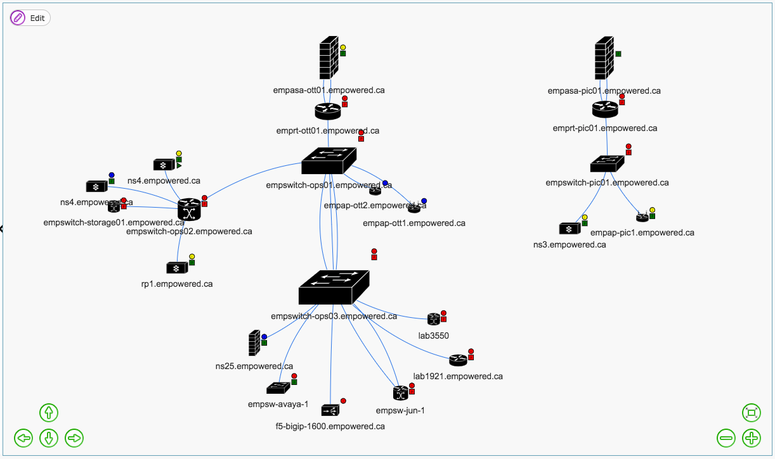
”Islands in the stream” problem

Slide 15
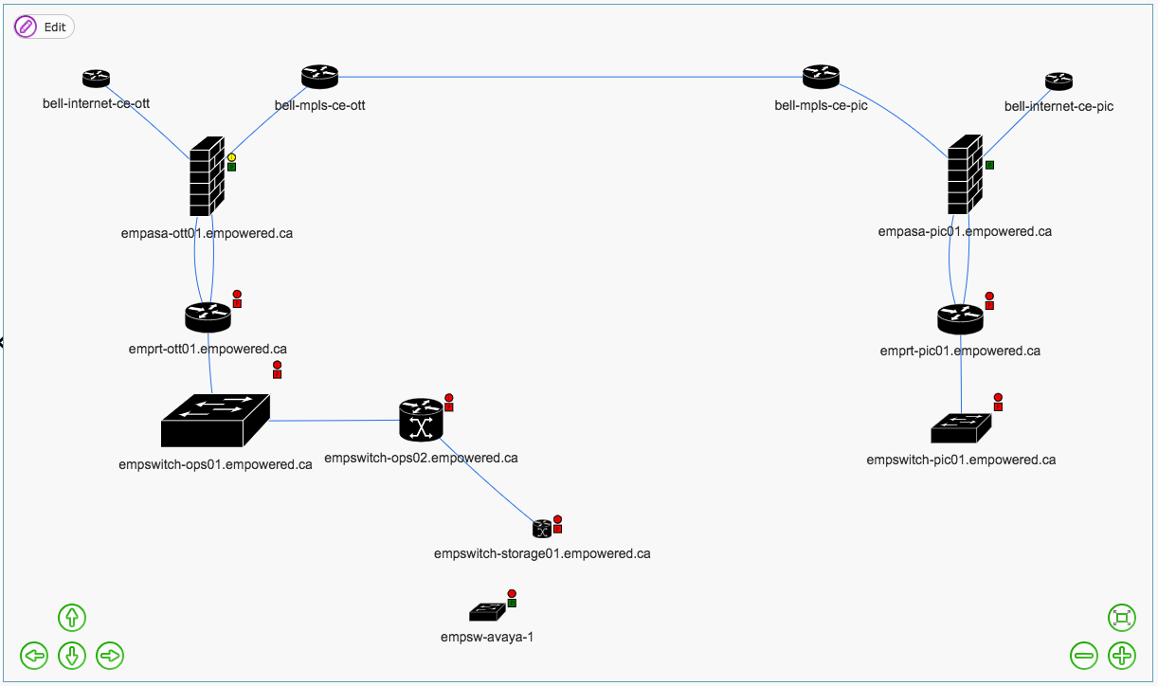
Fixed!

Slide 16
References
Devices supported in NetMRI 7.3.1:
https://docs.infoblox.com/display/NMRI731N83DSL/NetMRI+7.3.1+NIOS+8.3+Device+Support+List
Code example:
https://github.com/enihindyc/mikrotik-to-netmri

Slide 17



